Slide 1
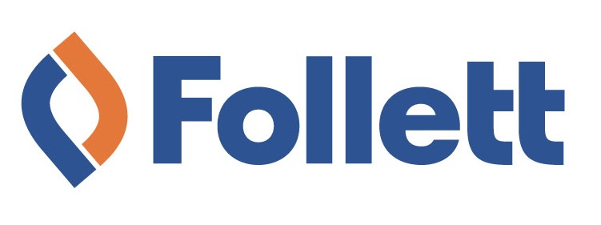
Student Attitudes Toward Content
in Higher Education
Thanks to our sponsors!

Slide 2
Textbook Requirement
Notes:
Since its inception, this study has tracked the decline of the traditional core textbook as the foundation of the higher ed curriculum. Seen here is the percentage of students who indicate that one or more textbooks were required for a given course. This has declined steadily each year of the study, dropping to 38% in the fall of 2014, where it remains.

Slide 3
Going Digital
Notes:
We’ve also watched the percentage of students with experience using digital materials grow. Seen here are those who say they’ve used digital materials for a course within the past two years. This hit a high of 73% in April 2015.

Slide 4
Going Digital
Notes:
While a slight majority still say they prefer print, in general, for their course materials, students who try digital are happy with their experience overall. Students reported satisfaction with the features, design, and subscription lengths available. They’re not so happy with price… (But when are they ever?)

Slide 5
Integrated Learning Systems
Have you taken a class using an Integrated Learning System?
Notes:
A growing number of students – 42% as of this April – have taken a course using an Integrated Learning System, such as Pearson’s MyLab or Cengage’s MindTap. The most commonly used systems are MyLab, McGraw-Hill Connect, Pearson’s Mastering, WileyPlus, and MindTap. Most students report use of the system was required, not merely suggested or recommended, but the professor did not fully integrate all aspects of it into the course.

Slide 6
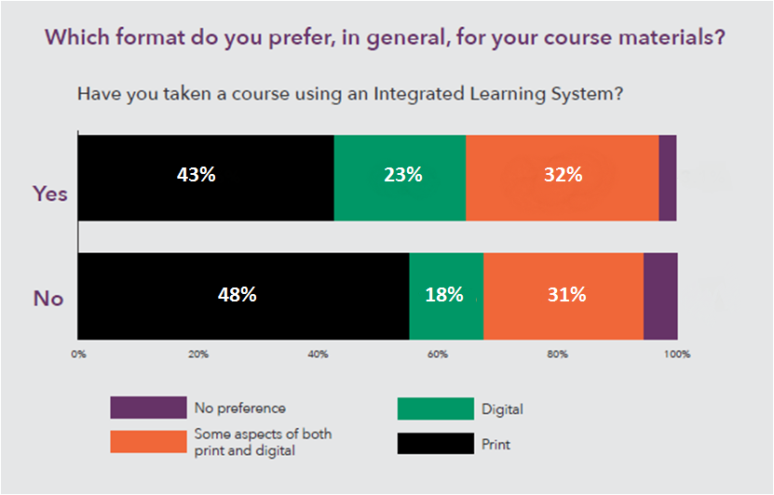
Integrated Learning Systems
Notes:
Amongst these students, we see an increased preference for digital, and for materials that include aspects of both digital and print. It’s worth noting here that digital AND print together are preferred by both groups, as opposed to digital alone. Those who have not used an ILS prefer a print/digital bundle very strongly over just digital.

Slide 7
Integrated Learning Systems
Notes:
The ILS rates highly compared to the traditional textbook. ILS users are happy with how the system helped them prepare for quizzes, complete assignments, and improve their grade. (However, note that around 1/3 of students were neutral about their ILS experience compared to the traditional text. While we’ve seen some improvement over the past year, there’s more that could be done to help students get value out of these systems, especially when it comes to providing assessments and tailoring content to individual needs.)

Slide 8
Active Learning
Notes:
Students are interested in having course content adapted to their needs. They prefer to be active, engaged learners via classroom discussions, and to receive frequent critiques and suggestions from instructors and peers. Students also react favorably to new “flipped learning” methodologies, which require them to research and learn key concepts before coming to class, as opposed to listening to lectures.

Slide 9
Defining Value
Preparing me for quizzes and exams
Helping me completing assignments
Helping me improve my grade
Guiding me in solving problems
Helping me master difficult concepts
Notes:
Students are pragmatic when it comes to their learning materials. They expect these materials to help them prepare for exams, complete assignments, solve problems, and master difficult concepts. They look to their materials to help improve their grades and make their study time more productive and efficient. (You might also notice that these highly-ranked value factors are also the areas where the ILS rated highly a few slides back.)

Slide 10
Defining Value
Notes:
Students are willing to pay for products they perceive as having value. They say they’d pay twice as much for tangible value (in the form of an improved grade and reduced study time) than they would pay for their current textbook.

Slide 11
Thanks for listening!
More information
available at: www.bisg.org/publications
or visit us in booth 864.
Nadine Vassallo
Project Manager, Research & Information
Book Industry Study Group
nadine@bisg.org

