Slide 1

YOUTH EREADING—OR NOT
WHAT DO WE KNOW?
IDPF 2015
MAY 26th, 2015
NEW YORK, NY

Slide 2

Hello!
Kristen McLean
Editor, Children’s Books in the Digital Age @BKGKristen

Slide 3

Sources
The primary sources for this report were:
NIELSEN BOOKSCAN
Physical point-of-sale data for the US trade market
NIELSEN BOOKS AND CONSUMERS
Consumer survey data focused on the US trade
NIELSEN CHILDREN’S DEEP DIVE
Consumer survey data focused on the US children’s book buyer and children’s reading habits.
THIRD-PARTY RESEARCH
BISG Higher Ed Study – 2015
SLJ Study of eBooks in School Libraries – 2014
Pew Study: Teachers & Technology – 2013
–
–

Slide 4

Methodology – Books & Consumers
How we make the donuts
ANNUAL TRACKER
72,000 unique consumers annually
CHILDREN’S DEEP DIVE
Two waves annually
Balanced to the US Census
Full Demographic profiles
ISBN verified
3,000 unique children’s buyers (subset above)
1,000 parents 0-6
1,000 parents 7-12
1,000 teens in book-buying households

Slide 5
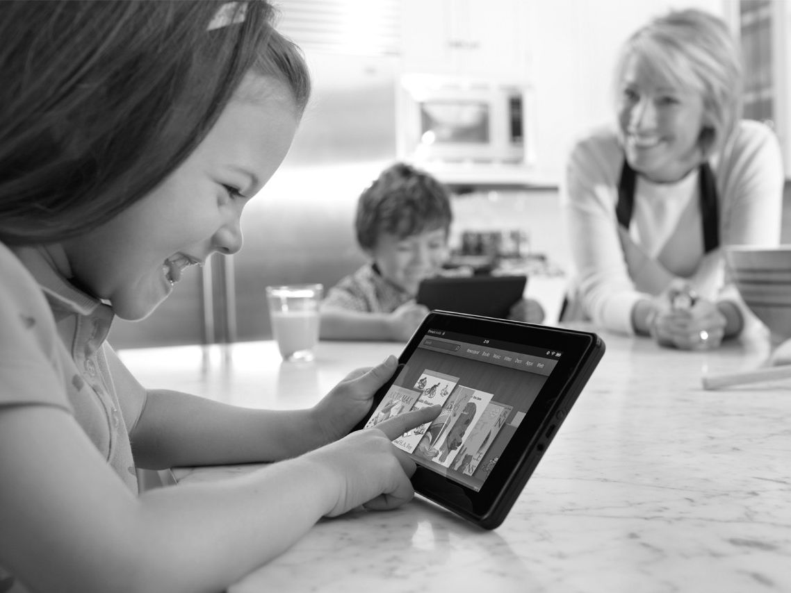
WHO ARE OUR READERS?
Notes:
WE HAVE TO THINK WHOLISTICALLY ABOUT YOUNG READERS – WE TEND TO ONLY IMAGINE THEM READING. THEY HAVE RICH, MULTIMEDIA LIVES – CONTENT BLEEDING SEAMLESSLY FROM ONE MEDIA TO ANOTHER

Slide 6
How many days a week do children read for fun?
5 to 7 Days
3 to 4 Days
GIRLS
BOYS
Notes:
In this slide we see almost 60% of girls 5-10 years old read 5 to 7 days a week. They start reading heavily earlier and the decline (compared to boys) ends later…..that sweet spot for boys really begins and ends in the 7 – 8 year old range.

Slide 7
TEENS THAT READ FOR FUN
On the rise after a dip in 2013
Source: Nielsen Children’s Deep Dive US, Fall2014
Notes:
Teen pleasure reading in bouncing back a bit

Slide 8
AVERAGE LEISURE TIME
0-6 (2014)
WEEKDAY
WEEKEND
MAGAZINES &
NEWSPAPERS
MAGAZINES &
NEWSPAPERS
ONLINE
MOVIES
ONLINE
MOVIES
VIDEO
GAMES
SOCIAL
NETWORKING
MUSIC
SOCIAL
NETWORKING
VIDEO
GAMES
MUSIC
OTHER:
(Sports, arts & crafts, playing w/ toys, etc.)
READING
OTHER:
READING
(Sports, arts & crafts, playing w/ toys, etc.)
TELEVISION
TELEVISION
Source Nielsen Children’s Deep Dive US, Fall 2014 :
Notes:
More music on weekdays, more other stuff on weekends.

Slide 9
AVERAGE LEISURE TIME
7-12 (2014)
SOCIAL
NETWORKING
MUSIC
MOVIES
MUSIC
ONLINE
MAGAZINES &
NEWSPAPERS
OTHER:
VIDEO
GAMES
(Sports, arts & crafts, playing w/ toys, etc.)
READING
TELEVISION
Source: Nielsen Children’s Deep Dive US, Fall 2014
Notes:
MORE TV THAN TEENS

Slide 10
Average LEISURE TIME
Teen (2014)
MOVIES
MAGAZINES &
NEWSPAPERS
READING
OTHER
ONLINE
OTHER:
(Exercise, shopping, sports, hobbies, etc.)
MUSIC
SOCIAL
NETWORKING
TELEVISION
VIDEO
GAMES
Music 360 2014: [ csocsmt0 ] – In a typical week, about how many hours of your leisure time do you personally spend on each of the following, when it is your primary activity? – (Teens: 1027)

Slide 11
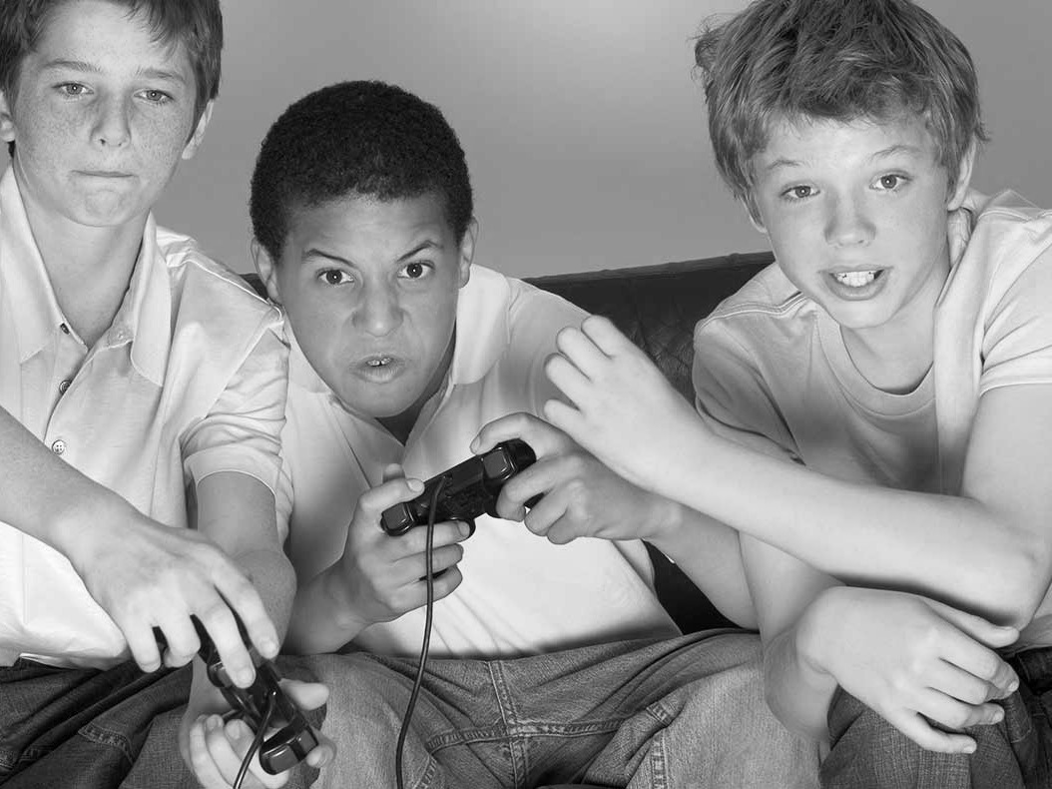
WHAT ARE OUR ASSUMPTIONS?
Notes:
ALL OUR OLD WAYS OF THINKING ARE WRONG

Slide 12
KID/TEEN GAMING IS NEAR-UNIVERSAL
TEENS
13-17
92%
66%
WEEKLY
P ARTICIPATION
KIDS
6-12
69%
92%
Source: Nielsen Games 360, Fall 2014

Slide 13
AND ALMOST ALL READERS ARE GAMERS
93% of Teen Readers also Game
WEEKLY
P ARTICIPATION
94% of Kid
Readers also Game
Source: Nielsen Games 360, Fall 2014

Slide 14

WHAT DO WE KNOW?
UNDERSTANDING
MARKET BASICS

Slide 15
2014: The Best Year to Date
Long Term Trend in Children’s Trade Books – Annual Physical Unit Sales
2004-2014 CAGR: 4%
Source: Nielsen Bookscan
15

Slide 16
The overall book industry is Mature
Long Term Trend in Trade Books – Annual Physical Unit Sales
2004-2014 CAGR: -1%
Source: Nielsen Bookscan
16

Slide 17
Adult Physical Sales peaked in 2008
Long Term Trend in Trade Books – Annual Physical Unit Sales
2004-2014 CAGR: -2%
Source: Nielsen Bookscan
17

Slide 18
Kids’ Books are OUTPERFORMING ADULT
YOY Physical Unit Sales by Type
Juvenile
Adult
2%
Decline
13%
Growth
Source: Bookscan

Slide 19
Juvenile’s growth is driving the industry
Overall US Physical Book Market Q4 2011 to Q3 2014
CAGR: 0%
CAGR: 10%
CAGR: 1%
CAGR: -2%
Source: Bookscan
Notes:
Rolling twelve month periods. While adult categories have remained relatively steady over recent years, the overall industry has grown due to Juvenile’s tremendous growth.
Even though it constitutes less than half of the industry Overall Juvenile has gone from a 30% market share 3 years ago to 35% market share this year.

Slide 20
Bigger and bigger
Overall Bestsellers 2014 (All Categories)
# | Title | Author | Imprint | Pub Date | YTD Sales
1 | THE FAULT IN OUR STARS | GREEN JOHN | SPEAK | 4/1/2014 | 1,708,169
2 | DIVERGENT | ROTH VERONICA | KATHERINE TEGEN BOOKS | 2/1/2012 | 1,399,710
3 | INSURGENT | ROTH VERONICA | KATHERINE TEGEN BOOKS | 5/1/2012 | 1,240,220
4 | ALLEGIANT | ROTH VERONICA | KATHERINE TEGEN BOOKS | 10/1/2013 | 1,083,885
5 | THE FAULT IN OUR STARS | GREEN JOHN | SPEAK | 4/1/2014 | 892,687
6 | GONE GIRL | FLYNN GILLIAN | BROADWAY BOOKS | 4/1/2014 | 846,624
7 | THE FAULT IN OUR STARS | GREEN JOHN | DUTTON JUVENILE | 1/1/2012 | 781,042
8 | THE LONG HAUL | KINNEY JEFF | AMULET BOOKS | 11/1/2014 | 699,928
9 | KILLING PATTON: THE STRANGE DE | O'REILLY BILL | HENRY HOLT & COMPANY | 9/1/2014 | 685,187
10 | LOOKING FOR ALASKA | GREEN JOHN | SPEAK | 1/1/2007 | 661,012
11 | IF I STAY | FORMAN GAYLE | SPEAK | 4/1/2010 | 651,264
12 | FROZEN | SAXON VICTORIA | RANDOM HOUSE DISNEY | 10/1/2013 | 600,279
13 | MINECRAFT: REDSTONE HANDBOOK: | SCHOLASTIC INC. | SCHOLASTIC INC. | 4/1/2014 | 597,286
14 | THE MAZE RUNNER | DASHNER JAMES | DELACORTE PRESS BOOKS FOR Y | 8/1/2010 | 588,701
15 | MINECRAFT: ESSENTIAL HANDBOOK: | SCHOLASTIC INC. | SCHOLASTIC INC. | 11/1/2013 | 577,180
16 | JESUS CALLING: ENJOYING PEACE | YOUNG SARAH | THOMAS NELSON PUBLISHERS | 10/1/2004 | 570,855
17 | FOUR | ROTH VERONICA | KATHERINE TEGEN BOOKS | 7/1/2014 | 552,728
18 | FROZEN: JOURNEY TO THE ICE PAL | BERRIOS FRANK | RANDOM HOUSE DISNEY | 10/1/2013 | 543,710
19 | HARD LUCK | KINNEY JEFF | AMULET BOOKS | 11/1/2013 | 512,219
20 | FROZEN: BIG SNOWMAN, LITTLE SN | RABE TISH | RANDOM HOUSE DISNEY | 10/1/2013 | 492,822
Source: Bookscan
Notes:
2014 has been an outlier, with Juvenile titles dominating the overall bestseller list.

Slide 21

WHAT DO WE KNOW?
WHAT PURCHASING
TELLS US

Slide 22
Shifts in WHERE CHILDREN’S books ARE BOUGHT
Consumer Survey Responses – Location of Book Purchases – Excludes YA
62%
bricks & mortar
Source: Nielsen Books & Consumer US, 2009-2014, excludes YA.
Notes:
Excluding YA this is the % of people buying through typical distribution channels. Add them up and we see that 62% of purchases are taking place at bricks and mortar stores.
From the bottom up we can see that the independent book store market has remained stable. As a source of discovery and the word of mouth way they build and make titles we can’t underestimate the importance of them to small and mid size publishers.
Mass Merchants, chain stores, and book fairs have all been in decline – largely due to the growth of onliners like Amazon….though it has been interesting to see how this channel has flattened over the last two years. Nonetheless, this online growth has resulted in eBook growth which is our next topic of discussion.

Slide 23
Purchasing platforms
books
Children’s book buyers do more than half of their book buying in person. Online and Direct Downloads slightly under-index for this group compared to the general market.
Index:
112
Platforms
In Store (in person)
Online Website
App/Direct Download
Other
Index:
Index:
133
82
Index:
93
Source: Nielsen 2014 Books and Consumers. Q4 2014

Slide 24
Purchasing platforms: Trended
books
In-Store purchases have slightly declined over the displayed time frame.
Online & Direct Downloads have seen increases since Q4 2013.
Platforms
In Store (in person)
Online Website
App/Direct Download
Other
Source: Nielsen 2014 Books and Consumers. 2013-2014

Slide 25
Book retailers
books
While nearly 45% of the overall book sales from these readers are derived from either Barnes & Noble, Amazon, or Walmart, the rest of the market is highly fragmented.
Top Retailers for
Children’s Book Buyers
Barnes & Noble
Amazon
Walmart
Target
Books-A-Million
Costco
Apple
Other Retailers
*50% “Other Retailers” dispersed
among more than 150
various retailers
Source: Nielsen 2014 Books and Consumers. Q4 2014

Slide 26
Book retailers: Trended
books
While B&N, Amazon, and Walmart have consistently made up close to half of the Retailer Children’s book market share, Q4 2014 represents their lowest stronghold over the displayed time frame
Top Retailers for
Children’s Book Buyers
Barnes & Noble
Amazon
Walmart
Target
Books-A-Million
Costco
Apple
*Bars do not reflect the full market, remaining percentages dispersed among more than 150 various retailers
Source: Nielsen 2014 Books and Consumers. 2013-2014

Slide 27

WHAT DO WE KNOW?
DIGITAL
READING

Slide 28
tablet usage by Children’s buyers
Which of the following devices do you own?
Source: Nielsen Books & Consumer US, 2011 through August2014
Notes:
A large part of our story today is going to be driven by tablets. Tablet penetration in our book-buying households has now reached 58%, more than double the penetration of stand-alone e-readers. (e-readers 26%)
It’s hard to overstate the impact tablets are having on the children’s market, and these devices are not only driving digital growth in the book market, they are impacting all areas of children’s content as we will see throughout the day.

Slide 29
Children are starting to read e-books younger
At What Age Did Your Child Start Reading eBooks?
Mean: 4.84
Mean: 7.19
Source: Nielsen Children’s Deep Dive US, Fall 2014
Notes:
THIS PARTLY REFLECTS THE SHORT TIMEFRAME OF EBOOKS IN OUR LIVES. CHILDREN BEING EXPOSED ACROSS AGE RANGES AT SAME TIME.

Slide 30
E-book Trends by Category – Children’s
E-book % Share of Books Purchased by Category
Adult & Juvenile
E-books
Juvenile E-books
Young Adult E-books
Children’s E-books
Juvenile Only
Source: Nielsen Books & Consumer US, 2011 thru June 2014
Notes:
In contrast, Juvenile e-books are gaining market share. We KNOW that YA e-books have seen strong growth—however when we separate out YA from juvenile, we see this is not just a YA phenomenon.

Slide 31
ebook percentage of total
technology
The percentage of eBooks relative to all books purchased has consistently outpaced the percentage of Children’s books that are eBooks, although the gap is shrinking
Only 10% of Children’s Book purchases for Q4 2014 were eBooks, compared to 19% of all books
Source: Nielsen 2014 Books and Consumers. 2013-2014

Slide 32
So e-book sales increase is tempered
10%
OF CHILDREN'S BOOKS PURCHASED
ARE E-BOOKS
Source: Nielsen Books & Consumer US, 2014
Notes:
We are now at 21% - up from 2% in 2010.

Slide 33
Print books REMAIN important for 0-12
How important are the following media?
Source: Nielsen Children’s Deep Dive US, Fall 2014
Notes:
80% of children’s books are still purchased in print, and print remains an important touchstone for children and families. This is a theme we will see emerge in many aspects of our presentations today. And interestingly, parental attitudes toward print have STRENGTHENED, even as they have increased their eBook buying.

Slide 34
When would you be more likely to buy an eBook or a print book?
(example responses)
Source: Nielsen Children’s Deep Dive US, Fall 2014

Slide 35

WHAT DO WE KNOW?
YOUNG ADULT

Slide 36
THE RISE OF YOUNG ADULT BESTSELLERS
Top 20 Juvenile Titles – 2011
# | Title | Author | Imprint | Pub Date | 2011
1 | THE HUNGER GAMES | COLLINS SUZANNE | SCHOLASTIC PRESS | 7/1/2010 | 1,577,952
2 | DIARY OF A WIMPY KID 6: CABIN | KINNEY JEFF | ABRAMS | 11/1/2011 | 1,563,302
3 | CATCHING FIRE | COLLINS SUZANNE | SCHOLASTIC PRESS | 9/1/2009 | 985,174
4 | INHERITANCE | PAOLINI CHRISTOPHER | ALFRED A. KNOPF BOOKS FOR YOUN | 11/1/2011 | 900,145
5 | MOCKINGJAY | COLLINS SUZANNE | SCHOLASTIC PRESS | 8/1/2010 | 853,314
6 | THE SON OF NEPTUNE BK 02 | RIORDAN RICK | HYPERION BOOKS | 10/1/2011 | 698,563
7 | THE KANE CHRONICLES, THE, BOOK | RIORDAN RICK | HYPERION BOOKS | 5/1/2011 | 534,605
8 | THE UGLY TRUTH | KINNEY JEFF | AMULET BOOKS | 11/1/2010 | 523,966
9 | ELF ON THE SHELF | AEBERSOLD CAROL V. | CCA & B | 12/1/2006 | 499,568
10 | THE WIMPY KID DO-IT-YOURSELF B | KINNEY JEFF | AMULET BOOKS | 5/1/2011 | 487,814
11 | RODRICK RULES | KINNEY JEFF | AMULET BOOKS | 2/1/2008 | 338,324
12 | GOODNIGHT MOON | BROWN MARGARET WISE | HARPERFESTIVAL | 8/1/1991 | 329,107
13 | DIARY OF A WIMPY KID | KINNEY JEFF | AMULET BOOKS | 4/1/2007 | 309,087
14 | THE HEROES OF OLYMPUS, THE, BO | RIORDAN RICK | HYPERION BOOKS | 10/1/2010 | 294,421
15 | DIARY OF A WIMPY KID: THE LAST | KINNEY JEFF | AMULET BOOKS | 1/1/2009 | 288,874
16 | AWAKENED | CAST P. C. | ST. MARTIN'S GRIFFIN | 1/1/2011 | 285,412
17 | GREEN EGGS AND HAM: 50TH ANNIV | DR SEUSS | RANDOM HOUSE CHILDREN'S BOOKS | 8/1/1960 | 282,374
18 | DIARY OF A WIMPY KID #4 - DOG | KINNEY JEFF | ABRAMS | 10/1/2009 | 273,985
19 | OH, THE PLACES YOU'LL GO! | DR SEUSS | RANDOM HOUSE CHILDREN'S BOOKS | 1/1/1990 | 261,923
20 | THE HUNGER GAMES TRILOGY BOXED | COLLINS SUZANNE | SCHOLASTIC PRESS | 8/1/2010 | 254,560
Source: Bookscan
Notes:
Top 20 Juvenile Bestsellers in 2011

Slide 37
THE RISE OF YOUNG ADULT BESTSELLERS
Top 20 Juvenile Titles – YTD thru Week 48 2014
# | Title | Author | Imprint | Pub Date | YTD Sales
1 | THE FAULT IN OUR STARS | GREEN JOHN | SPEAK | 4/1/2014 | 1,732,157
2 | DIVERGENT | ROTH VERONICA | KATHERINE TEGEN BOOKS | 2/1/2012 | 1,403,653
3 | INSURGENT | ROTH VERONICA | KATHERINE TEGEN BOOKS | 5/1/2012 | 1,249,813
4 | ALLEGIANT | ROTH VERONICA | KATHERINE TEGEN BOOKS | 10/1/2013 | 1,092,487
5 | THE LONG HAUL | KINNEY JEFF | AMULET BOOKS | 11/1/2014 | 921,742
6 | THE FAULT IN OUR STARS | GREEN JOHN | SPEAK | 4/1/2014 | 897,941
7 | THE FAULT IN OUR STARS | GREEN JOHN | DUTTON JUVENILE | 1/1/2012 | 783,135
8 | LOOKING FOR ALASKA | GREEN JOHN | SPEAK | 1/1/2007 | 672,344
9 | IF I STAY | FORMAN GAYLE | SPEAK | 4/1/2010 | 667,870
10 | FROZEN | SAXON VICTORIA | RANDOM HOUSE DISNEY | 10/1/2013 | 629,080
11 | MINECRAFT: REDSTONE HANDBOOK: | SCHOLASTIC INC. | SCHOLASTIC INC. | 4/1/2014 | 612,832
12 | THE MAZE RUNNER | DASHNER JAMES | DELACORTE PRESS BOOKS FOR YOUN | 8/1/2010 | 601,700
13 | MINECRAFT: ESSENTIAL HANDBOOK: | SCHOLASTIC INC. | SCHOLASTIC INC. | 11/1/2013 | 594,709
14 | FOUR | ROTH VERONICA | KATHERINE TEGEN BOOKS | 7/1/2014 | 567,431
15 | FROZEN: JOURNEY TO THE ICE PAL | BERRIOS FRANK | RANDOM HOUSE DISNEY | 10/1/2013 | 564,756
16 | HARD LUCK | KINNEY JEFF | AMULET BOOKS | 11/1/2013 | 525,303
17 | FROZEN: BIG SNOWMAN, LITTLE SN | RABE TISH | RANDOM HOUSE DISNEY | 10/1/2013 | 511,098
18 | PAPER TOWNS | GREEN JOHN | SPEAK | 9/1/2009 | 504,535
19 | FROZEN: A TALE OF TWO SISTERS | LAGONEGRO MELISSA | RANDOM HOUSE DISNEY | 10/1/2013 | 486,328
20 | FROZEN: THE JUNIOR NOVELIZATIO | NATHAN SARAH | RANDOM HOUSE DISNEY | 10/1/2013 | 455,842
Source: Bookscan
Notes:
Top 20 Juvenile Bestsellers today – YA is dominating the juvenile category, almost to the exclusion of traditional juvenile books.
Part of this is driven by groups of books joining the list in related waves—John Green & Veronica Roth as examples.

Slide 38
THE RISE OF YOUNG ADULT BESTSELLERS
Count of YA ISBNs in Bookscan Juvenile Bestselling Top 20 – 2006 thru Week 48 2014
Source: Bookscan

Slide 39

Adults are heavy YA readers
80%
Y
A
OF YOUNG ADULT BOOKS ARE
BOUGHT BY ADULTS FOR THEMSELVES
Source: Nielsen Books & Consumer US, Spring 2014.

Slide 40
DIGRESSION: Characteristics of JNF Buyers
Approximately 27% of JNF books purchased are by adults with no children and not as gifts.
15%
OF JNF BOOKS PURCHASED WERE GIFTS
Source: Nielsen Books and Consumers, 2013 and 2014 thru May per PubTrack Books and Consumers. Survey does not include buyers less than 13 years of age. Percentages reflect % share of JNF Buyers, Indices are % JNF/ % all US book buyers * 100
Notes:
Another example of adult cross over affecting sales – 27% of JNF books purchased by adults without kids for self. This cross-pollination of content categories is something that is showing up in many aspects of our presentations today – children are absorbing adult media, and adults are absorbing kids media.

Slide 41
WHAT FORMAT DO TEENS PREFER?
Source: Nielsen Children’s Deep Dive US, Fall 2013-Fall 2014.
Notes:
Attitudes toward print strengthening

Slide 42

WHAT DO WE KNOW?
DIGITAL & EBOOKS
IN EDUCATION

Slide 43

“Our students love ebooks for research, but do not want to check out pleasure reading in e-format. They demand print for their fiction and extracurricular reading needs.”
- Librarian, SLJ Study
Notes:
Retrieved from: http://www.slj.com/wp-content/uploads/2014/11/LJSLJ_EbookUsage_SchoolLibraries_2014.pdf

Slide 44

“I have found the transition to eBooks to be very frustrating. I seem to be more excited about them than the students are!”
- Librarian, SLJ Study
Notes:
Many schools cite lack of devices. 1-1 schools report increased uptake, but still low.
In the 2013-2014 school year, about one-in-five schools (17%) had some sort of one-to-one program in place and another 15% were considering adding one.
Retrieved from: http://www.slj.com/wp-content/uploads/2014/11/LJSLJ_EbookUsage_SchoolLibraries_2014.pdf

Slide 45

School Library E-book Circulation - 2014
Have you experienced a change in demand for eBooks since this time last year?
% of school libraries, 2014
Source: SLJ 2014 EBOOK USEAGE IN SCHOOL (K-12) Libraries – 5th Annual Survey
Notes:
Source: SLJ 2014 EBOOK USEAGE IN SCHOOL (K-12) Libraries – 5th Annual Survey
Fielded from: April 4, 2014 to July 2, 2014.
SAMPLE: 835 U.S. school libraries.
Numbers shown in total were weighted based on NCES (National Center for Education Statistics) data to represent the percentage breakdown of U.S. school libraries (Elementary, Middle School, High School) nationwide.

Slide 46
School Library E-book Circulation - 2014
Approximately what was your total ebook usage/circulation for the last school year?
% of school libraries, 2012–2013 school year
Source: SLJ 2014 EBOOK USEAGE IN SCHOOL (K-12) Libraries – 5th Annual Survey
Notes:
Source: SLJ 2014 EBOOK USEAGE IN SCHOOL (K-12) Libraries – 5th Annual Survey
Fielded from: April 4, 2014 to July 2, 2014.
SAMPLE: 835 U.S. school libraries.
Numbers shown in total were weighted based on NCES (National Center for Education Statistics) data to represent the percentage breakdown of U.S. school libraries (Elementary, Middle School, High School) nationwide.

Slide 47
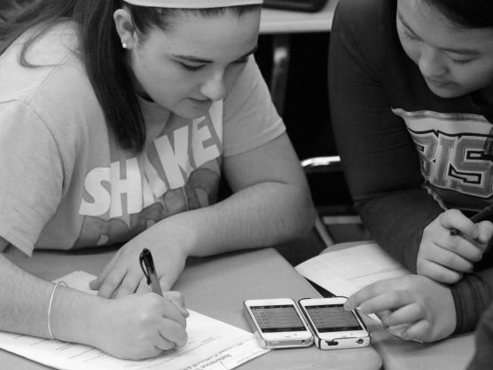
73%
AP or NWP students use phones or tablets to complete assignments in class
Notes:
A survey of 2,462 Advanced Placement (AP) and National Writing Project (NWP) teachers finds that digital technologies have helped them in teaching their middle school and high school students in many ways.
Retrieved from: http://www.pewinternet.org/files/old-media//Files/Reports/2013/PIP_TeachersandTechnologywithmethodology_PDF.pdf
Pew Research Center: How Teachers Are Using Technology at Home and in Their Classrooms, 2013

Slide 48

FREQUENCY OF ASSIGNED FORMATs - COLLEGE
What format was the textbook for this course? - 2015
64%
Source: BISG’s 2015 Student Attitudes Toward Content in Higher Education Study
Notes:
Purchase: https://www.bisg.org/publications/student-attitudes-toward-content-higher-education

Slide 49

College Students’ Preference for Format
Which format do you prefer, in general, for your course materials? 2015
Source: BISG’s 2015 Student Attitudes Toward Content in Higher Education Study
Notes:
Purchase: https://www.bisg.org/publications/student-attitudes-toward-content-higher-education

Slide 50
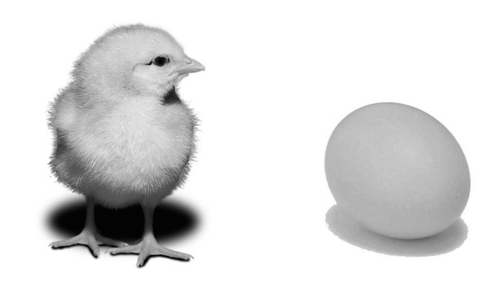
CONCLUSIONS?
Q&A
Notes:
IS IT ABOUT DEVICE ACCESS?
IS IT PREFERENCES FOR CONTENT PACKAGING?
WANTING TO BE UNPLUGGED?
PHYSIOLOGY?
GENERATIONAL?
GPS VERSUS MAPS? – DIFFERENT USES FOR DIFFERENT SITUATIONS?

Slide 51
Thanks!
Kristen McLean
Editor, Children’s Books in the Digital Age @BKGKristen

