Slide 2
Base: Children Ages 6–17
Whether Children Are Currently Reading Books for Fun

Slide 3
Base: Children Ages 6–17
Comparison of How Much Children Enjoy Reading Now to When They Were Younger

Slide 4
Base: Children Ages 6–17
Degree to Which Children Enjoy Reading Books for Fun

Slide 5
Base: Children Ages 6–17 Who Read Independently With Their Class or School at a Certain Time
How Children Feel About Independent Reading Time at School

Slide 6
Favorite Books or Series of Children Ages 9–11

Slide 7
What Kids Want in Books

Slide 8
Meet Kids Where They Are
Humor
Novelty
Creativity
Authenticity
Agency

Slide 9
Provide Choice

Slide 10
Nonfiction Provides an Outlet for Differentiation
Help Kids Develop “Expertise”

Slide 11
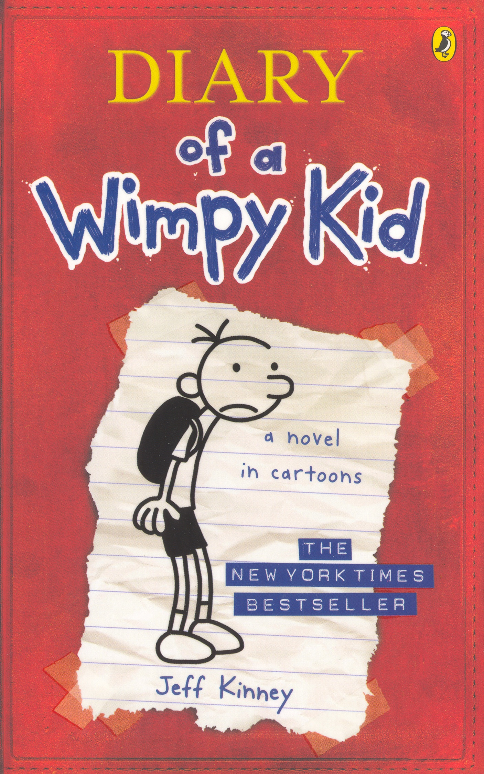
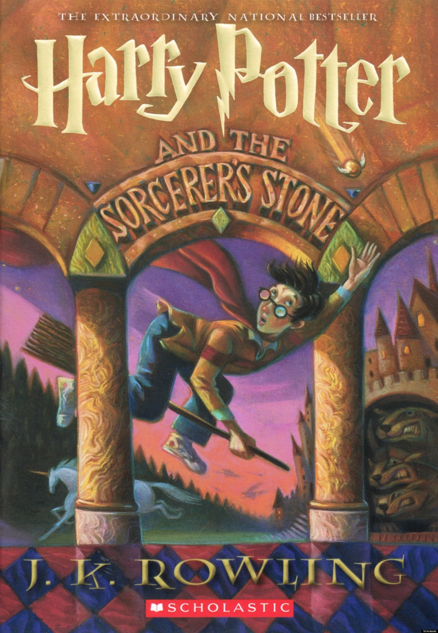
Real World
Practice Bibliotherapy for Boys
Character Arc
Challenged
(but maintain sense of humor & friends’ help)
Problem to Be Solved
(different)
Accepts/ Celebrates Uniqueness
Fantasy World

Slide 12
i
Harness the Power of Technology, or
i
nteractive
ndividualized
nnovative
D Y
nviting
i
i
i
i

Slide 13
“
E-Books
Struggling readers were the strongest advocates of e-books, suggesting that e-books helped them gain confidence in their reading abilities.
Lotta Larson
Educational Leadership
May 2015

Slide 14
Don’t Stop Reading Aloud
“
Francie,
I thought these stories will bring back memories of our famous conversations. I hope you enjoy them.
Love,
Brady

Slide 15
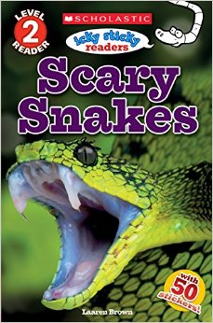
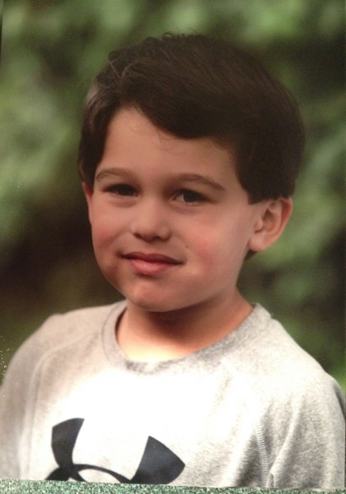
Benjamin and His Books

Slide 16
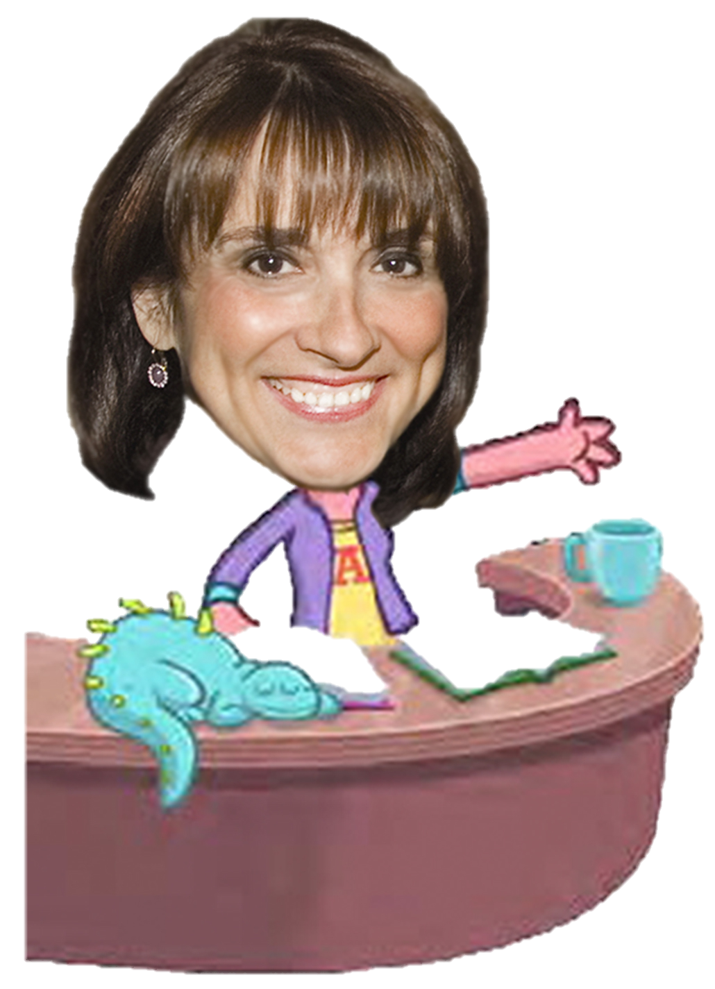
The Bibliotherapist Is In! Francie Alexander Senior Vice President & Chief Academic Officer Scholastic Education FAlexander@scholastic.com @FrancieCAO

