Slide 1
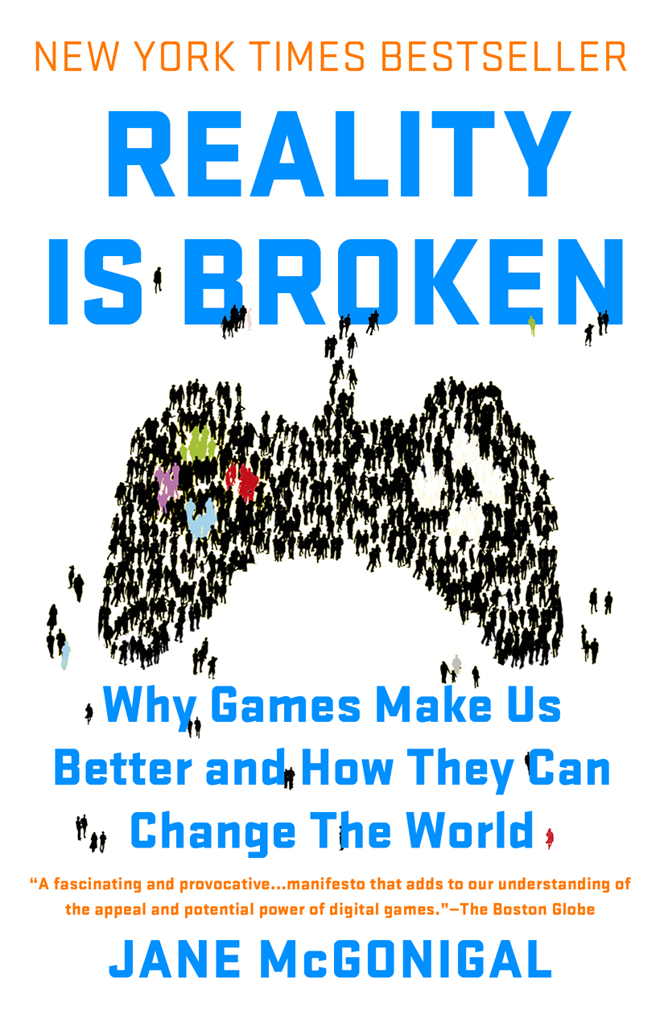
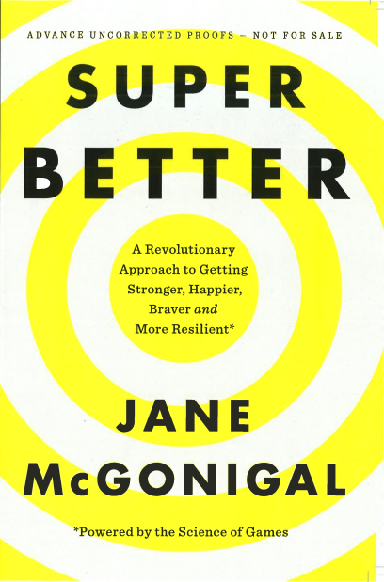
Notes:
The power of games to create whole-hearted engagement with difficult challenges, and the ability of online, collaborative games in particular to teach 21st century skills

Slide 2
1 Billion Gamers
38
110
17
187
80
18
105
311
16
10
35
2
14
Notes:
(total here is 943)

Slide 3
1.75 billion minutes a day crushing candy 3.3 million years

Slide 4
170 hours a year per player…
Or 1 month of full-time work every year

Slide 5
1 in 4 players
called in sick
to stay home and
play on
launch day.
Notes:
Financial capital is not the primary resource we’re talking about in the egnagemetn economy, although you can measure….

Slide 6
81 % of global workers are not engaged. *
*Gallup 2014 engagement survey

Slide 7
The longer you stay in school, the less engaged you become.
. 76%
% Engaged
Elementary Middle High School
. 61%
. 44%
Notes:
With every year that passes between 5th and 12th grade, the number of students who are engaged in school declines steadily, according to the Gallup Student Poll, released last month.
A majority of elementary school students—almost eight in 10—qualify as engaged, the poll found. By middle school, however, that number drops to six in 10 students. And when students enter high school, it drops to four in 10.
The poll surveyed approximately 500,000 students from 37 states in over 1,700 public schools in 2012. Each year, as we've previously covered, Gallup measures students' levels of engagement, hope, and well-being at any schools that opt to participate. According to Gallup, those three measures account for one-third of the variance in student success.

Slide 8
52% of Americans feel they have no direct way to help solve problems in their community, or to impact larger society in a positive way
*Pew Research Civic Engagement survey 2013

Slide 9
7+ billion hours a week…
266m
770m
1.3b
119m
560m
126m
2.17b
112m
735m
70m
245m
14m
98m
… of MAXIMUM ENGAGEMENT
Notes:
(total here is 943)

Slide 10
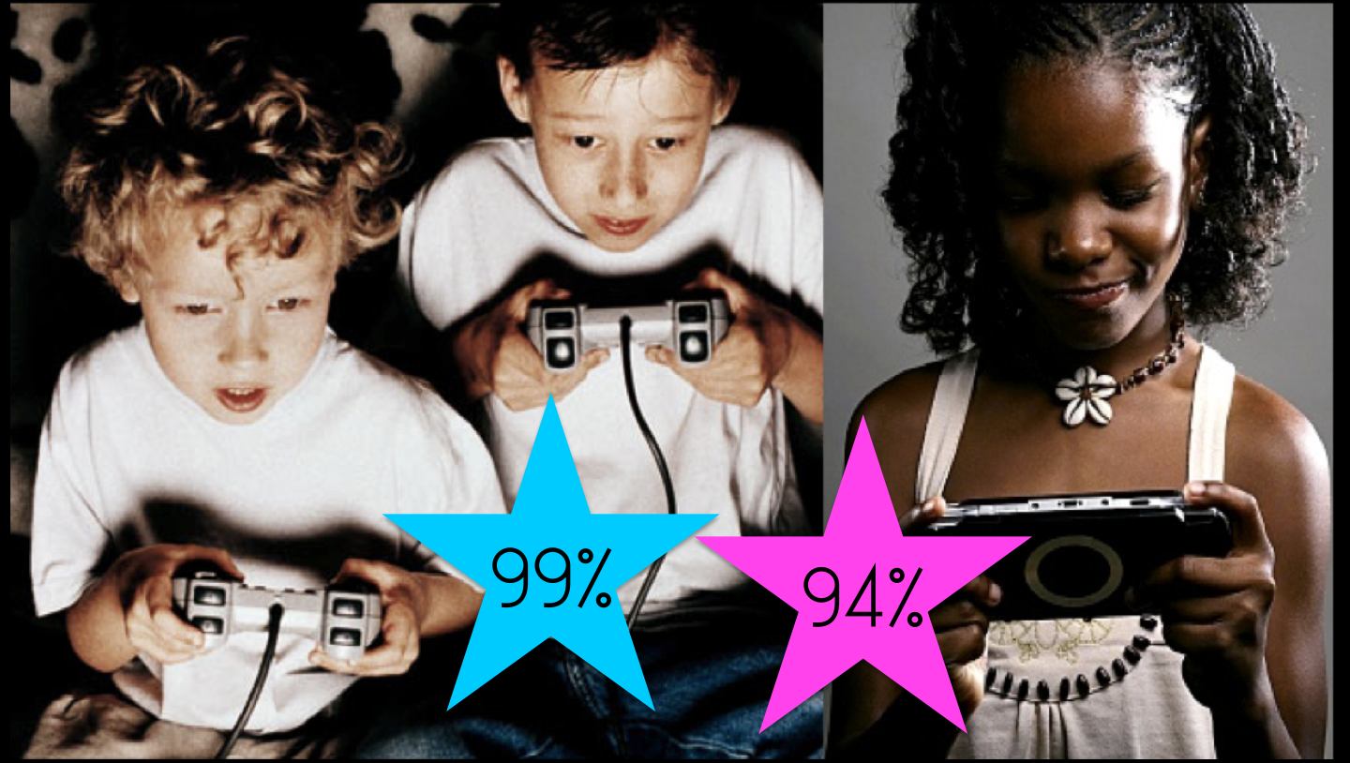
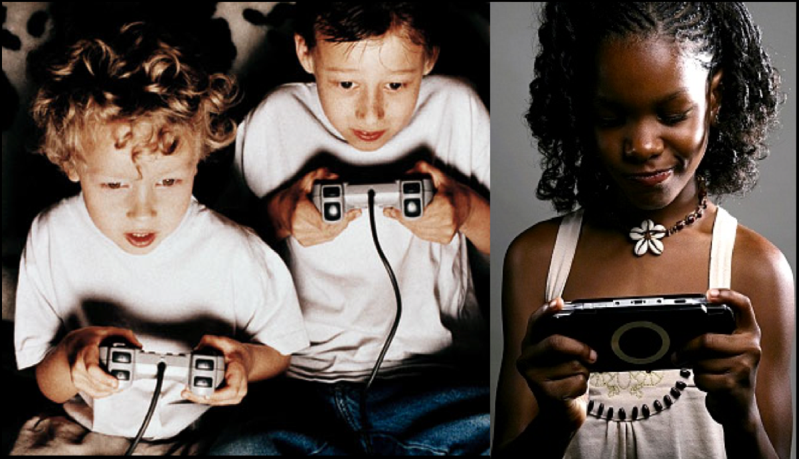
99%
94%

Slide 11
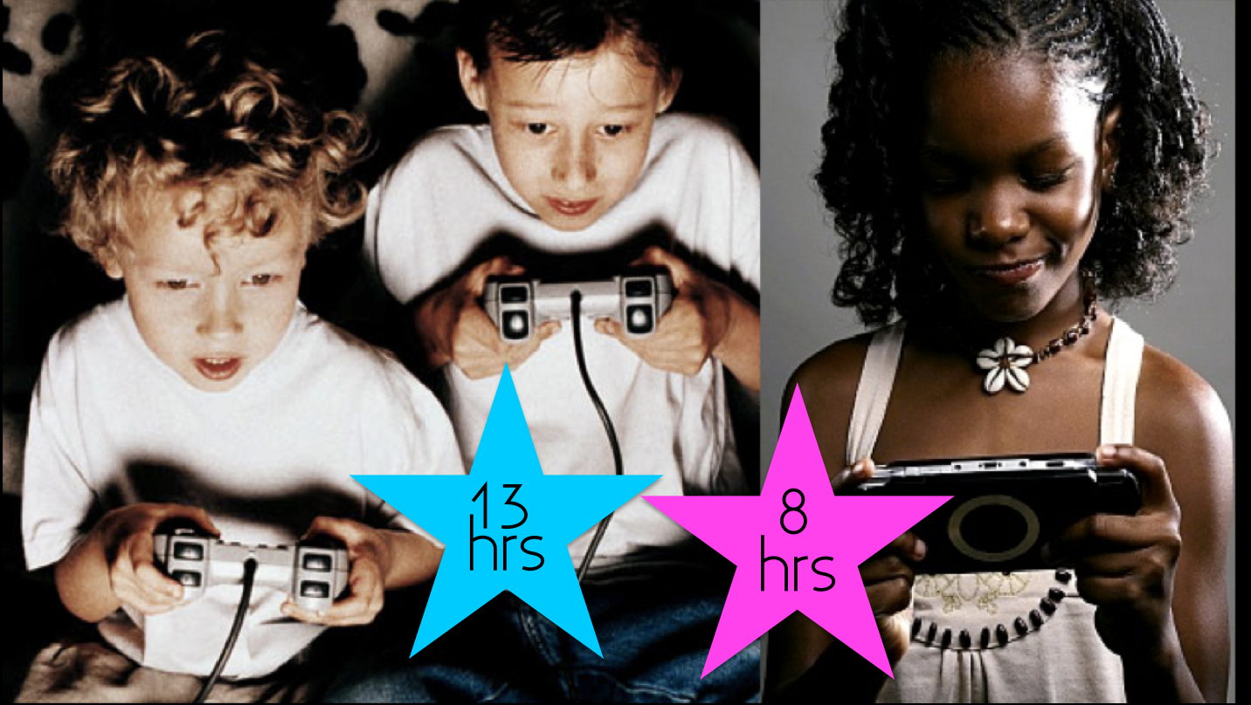
13
hrs
8
hrs

Slide 13
“It’s inevitable.
Soon we’ll all be gamers.”

Slide 14
10 Positive Emotions
10. Joy
9. Relief
8. Love
7. Surprise
6. Pride
5. Curiosity
4. Excitement
3. Awe & Wonder
2. Flow
1. Creativity
Notes:
Curiosity – what the hell is MMTW? Creativity – how do we get all the thumbs connected? Surprise – what happens when you actually try to wrestle two thumbs at once? Excitement – as people start to really try hard, or win Pride – we all mastered a new skill! Contentment – happy to be spending our time that way Awe & Wonder – MMTW is more epic than plain old TW

Slide 15
10 Positive Emotions
10. Joy
9. Relief
8. Love
7. Surprise
6. Pride
5. Curiosity
4. Excitement
3. Awe & Wonder
2. Flow
1. Creativity
Notes:
Curiosity – what the hell is MMTW? Creativity – how do we get all the thumbs connected? Surprise – what happens when you actually try to wrestle two thumbs at once? Excitement – as people start to really try hard, or win Pride – we all mastered a new skill! Contentment – happy to be spending our time that way Awe & Wonder – MMTW is more epic than plain old TW

Slide 16
Positive emotions make us RESILIENT.

Slide 18
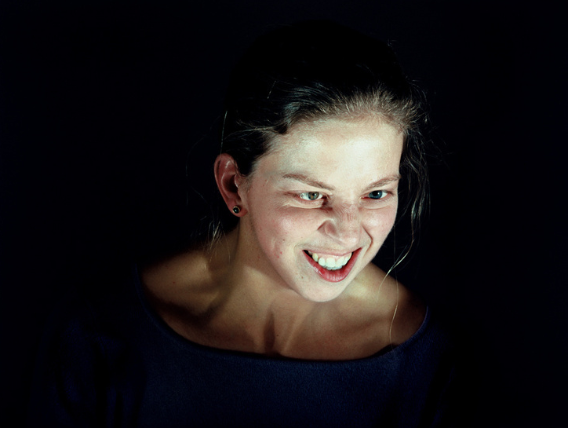

Slide 21
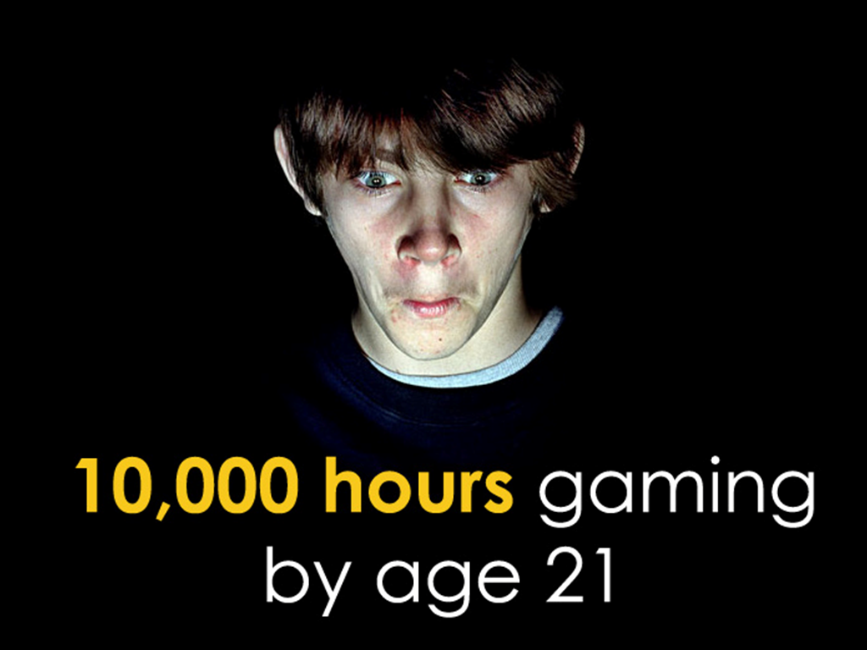

Slide 23
“The opposite of play isn’t work –
it’s depression.”
Notes:
When we’re depressed, according to the clinical definition, we suffer from two things: a pessimistic sense of inadequacy and a despondent lack of activity. If we were to reverse these two traits, we’d get something like this: an optimistic sense of our own capabilities and an invigorating rush of activity. There’s no clinical psychological term that describes this positive condition. But it’s an absolutely perfect description of the emotional state of gameplay. A game is the opportunity to focus our energy, with relentless optimism, at something we’re good at and enjoy. This is a crucial point, so I’ll repeat it: Gameplay is the direct emotional opposite of depression.

Slide 25
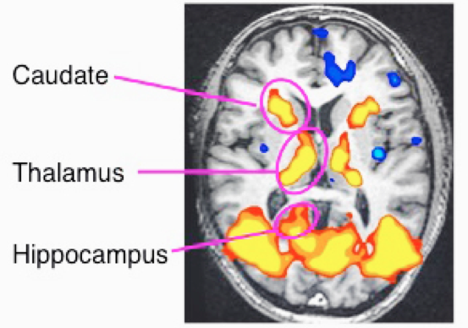
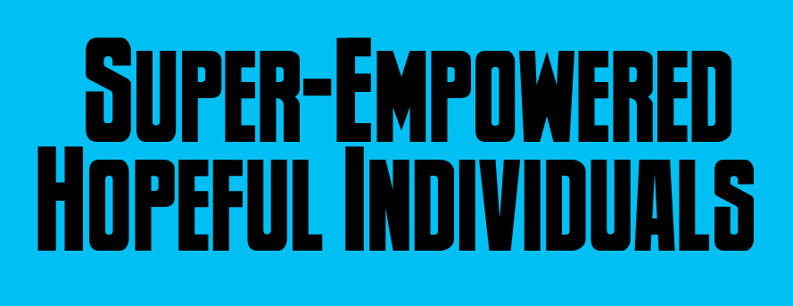
Notes:
Every game is a power fantasy… but not the power of blowing things up, etc… it’s the power to have a real impact on the world around us.

Slide 28
(play Find the Future trailer)
Notes:
(trailer can be downloaded at http://dl.dropbox.com/u/10332846/Trailerv6FIXForReview.mov
Or viewed at http://www.youtube.com/watch?v=8HjjMv4LvbM

Slide 37
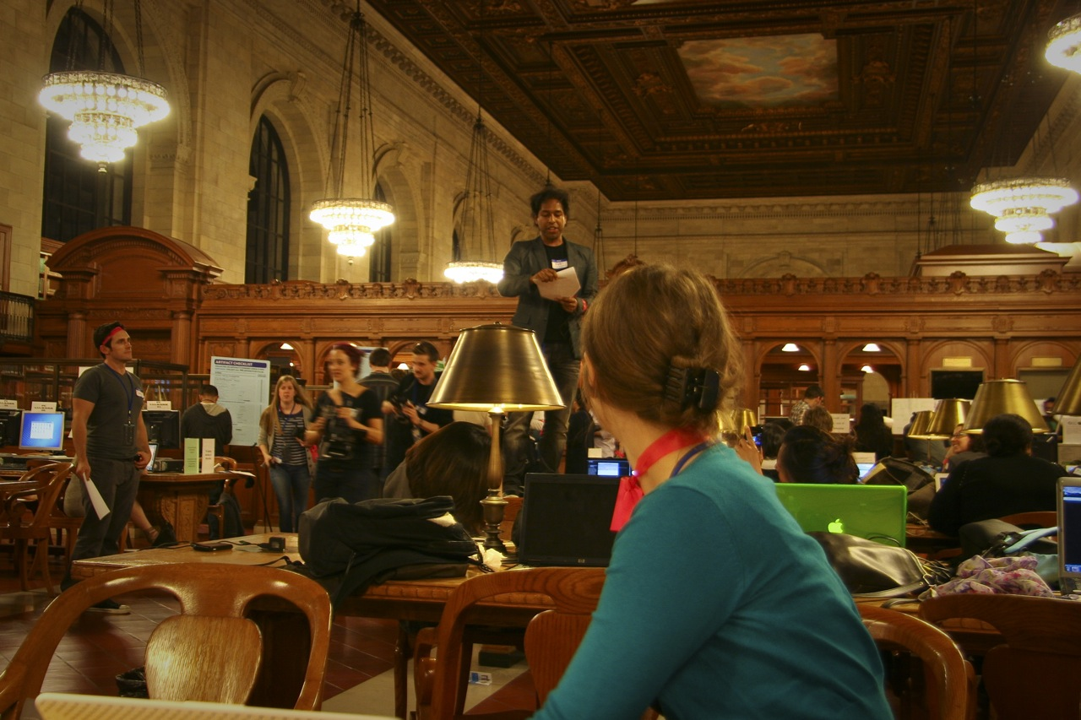

Slide 38
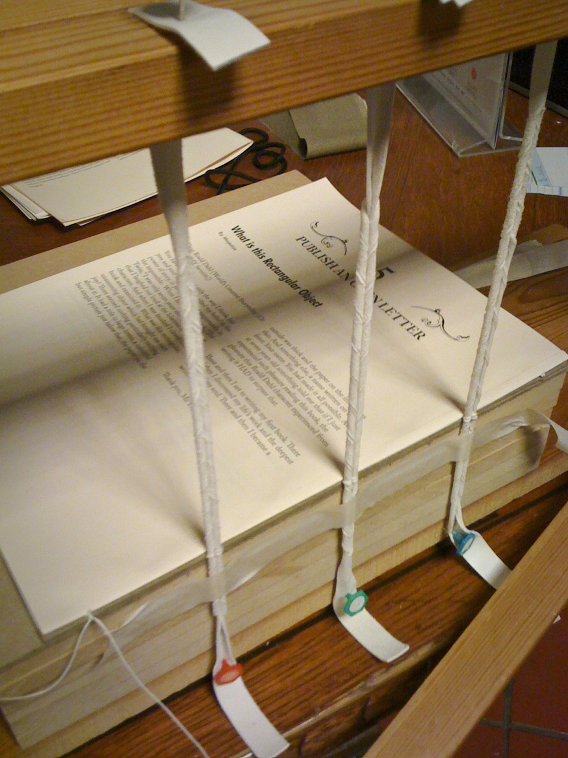

Slide 42
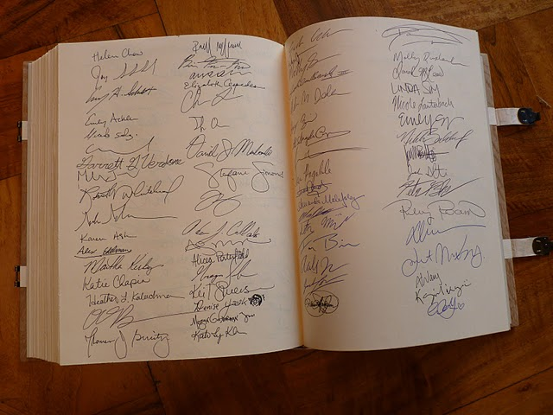

Slide 44
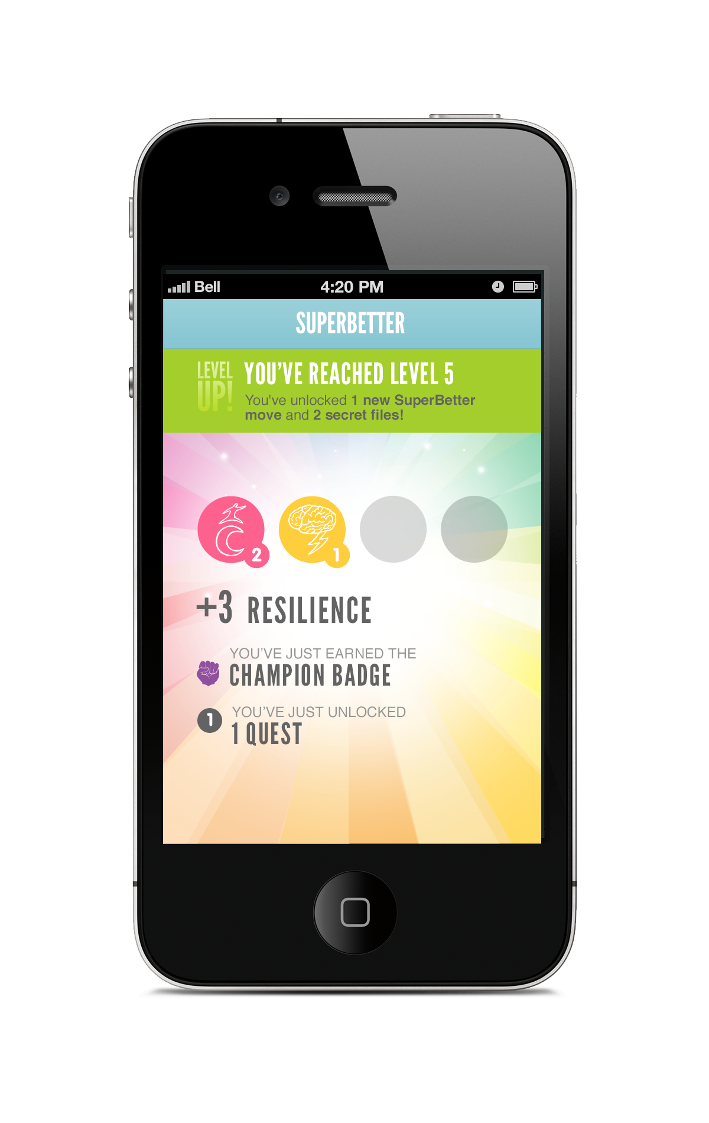
Notes:
of…

Slide 45
10 Positive Emotions
10. Joy
9. Relief
8. Love
7. Surprise
6. Pride
5. Curiosity
4. Excitement
3. Awe & Wonder
2. Flow
1. Creativity
Notes:
Curiosity – what the hell is MMTW? Creativity – how do we get all the thumbs connected? Surprise – what happens when you actually try to wrestle two thumbs at once? Excitement – as people start to really try hard, or win Pride – we all mastered a new skill! Contentment – happy to be spending our time that way Awe & Wonder – MMTW is more epic than plain old TW

Slide 46
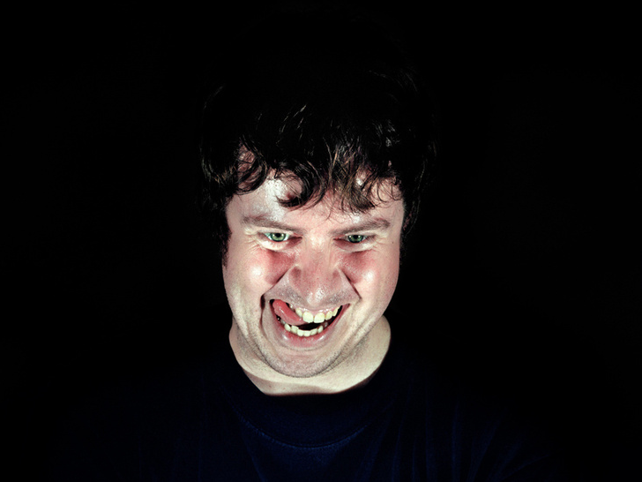
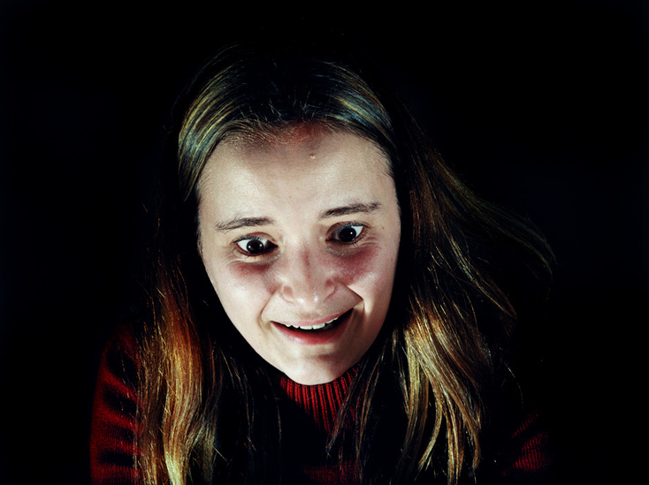
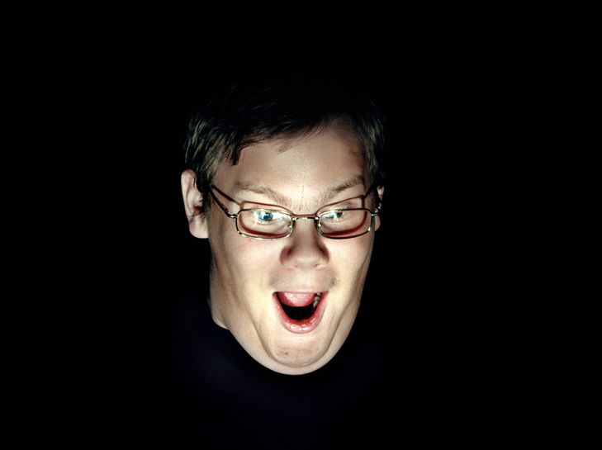
Notes:
They want to feel like this – but they don’t. What makes the difference?

