Slide 1
The Customer as Curator
@michaelbhaskar

Slide 2
Curation has become a buzzword - we curate everything
Notes:
This is a story of a buzzword. Apologies. I’ve wracked my brains and it’s still the best word we have. But this means we miss many of the most powerful effects of curation. We write curation off as something for Brooklyn hipsters, not something that is serious in business. Nonetheless we need to pay attention.

Slide 3
A context of abundance, new technology and social means readers are the power brokers that matter most
Notes:
The short answer:

Slide 4
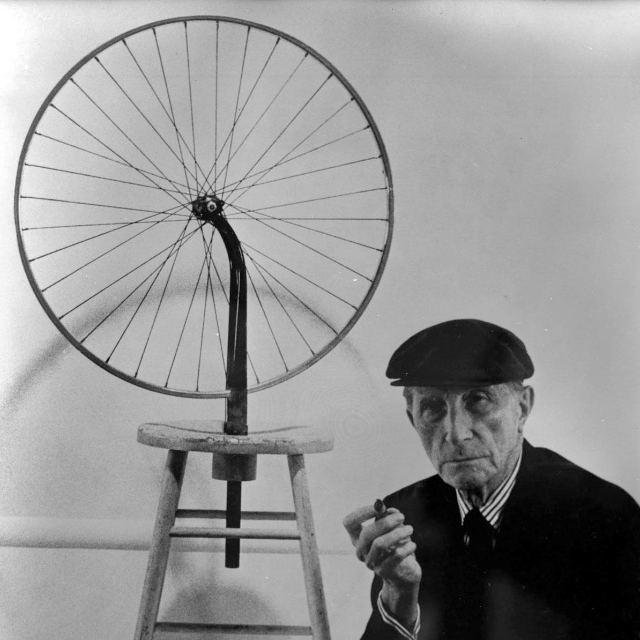
Notes:
We think curation is about something like this. Marcel Duchamp, also known for his urinal. A silly art joke. Yes, but this also shows the power of curation. One of the most famous works of art, validated because of curation.

Slide 5
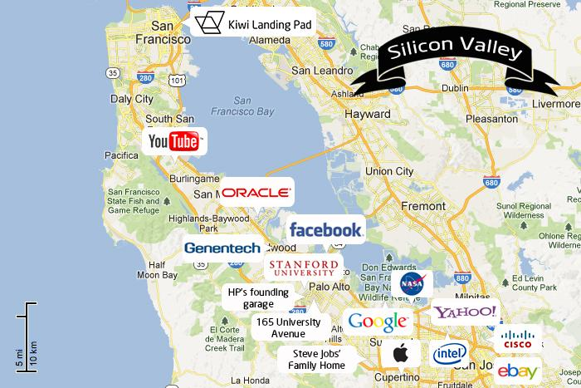
Notes:
Actually a lot of these business, and the huge tech bubble is based on curation. There is a difference between explicit and tacit curation. Explicit is people curating their burgers on Instagram. Tacit is sorting and coping with data overload and making huge amounts of money in the process. The first is open to parody; the second is altogether harder to spot but is a crucial change in how the economy works. Curation spread from art to the web and now is everywhere.

Slide 6
But what about publishing?
Notes:
I started thinking about curation a few years ago when I kept noticing it. Got me thinking - was this a trivial fad? Was this something important? I’d have discussions with everyone in the publishing industry about curating. Everyone used the word, seemed to think it was important. I began to wonder and started thinking about this...

Slide 7
Curation
How the Power of Selection is Managing Overload, Remaking Culture and Changing Business

Slide 8
Two examples of curation from a book startup...
Notes:
Village Voice, James Marcus - old style editors, hand curation. Greg Linden - algorithmic curation. Personalization. P13N team. Whole new way of doing business. Both reacting to the fact that Amazon is the world’s biggest bookstore. Hints at the fundamental problem in books today.

Slide 9
+1,000,000
Notes:
The number of new books published every year in the English language. We have an excess, an abundance of books. That is before you even get to the excess of other media. The single biggest challenge of publishing today is not retail, is not marketing, is not margins - it’s the sheer mass of product out there. This is the underlying, deep seated and most powerful problem the book industry faces. In short: there are way more than enough books.

Slide 10
The average American consumes information equivalent to 175 newspapers every day
Notes:
Information overload is an even more widespread phenomenon. IBM estimates the world now produces over 2.5 quintillion bytes of data – that is, 2,500,000,000,000 megabytes – every day. If you wrote out all the ones and zeros of just one megabyte in longhand, the line would be five times taller than Mount Everest. Facebook alone deals with 2.5 billion pieces of content and 500 terabytes each day. In the past two years alone, humanity has produced more data than the rest of human history combined, and this extraordinary rate of production is still growing by 60% a year.

Slide 11
Curation = selecting + arranging to add value
That’s it
Notes:
Arranging has lots of value - behavioral studies increasingly focused on this. We don’t often notice it, but curation is the interface between people, readers, customers and the great abundance we have created in the world. This interface is becoming more important than ever.

Slide 12
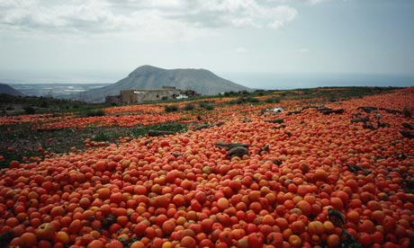
Notes:
Surplus tomatoes in Tenerife. Excess and abundance are the norm, not just in books - 200 years of rising productivity in virtually every area, from shampoo to motor cars, wine to media, mean that we have excess. The point about this is that curation becomes the main store of value. Ask yourself: which is more valuable: adding another book or finding someone the right one?

Slide 13
Welcome to the curation economy
Notes:
Netflix’s better curation paid a part in the downfall of Blockbuster...which once turned down the opportunity to buy Netflix!

Slide 15
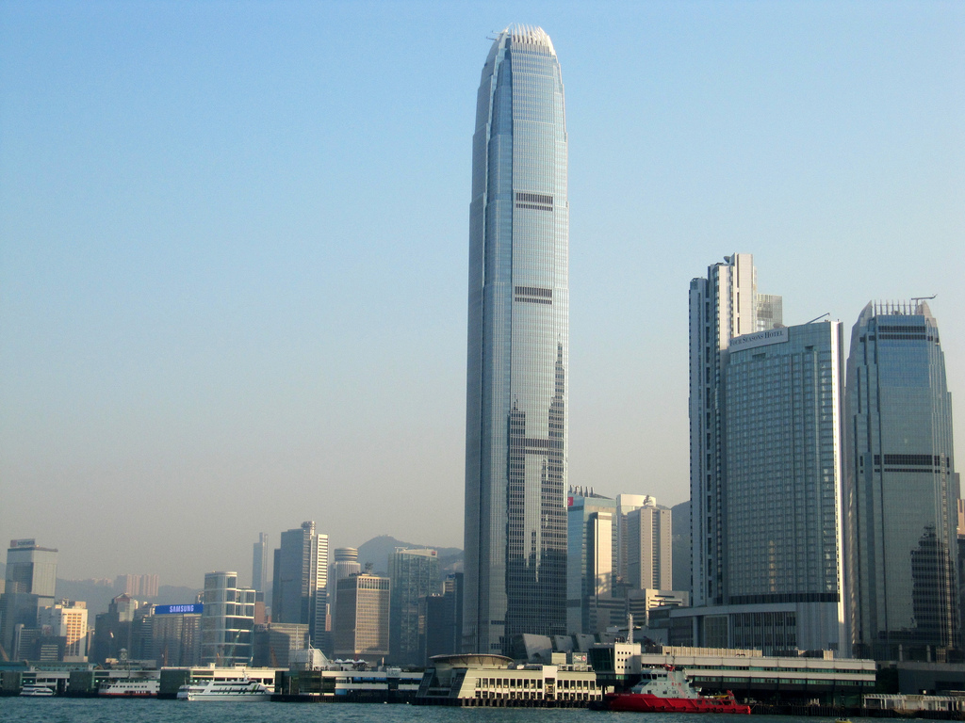
Notes:
The IFC mall only survives in one of the most competitive retail environments globally by curating - it’s careful selection puts it ahead

Slide 16
Notes:
In Abu Dhabi they are building saadiyat Island which follows the Bilbao model - putting curation at the heart of economic development

Slide 17
Notes:
Facebook is now, for many people around the world, their gateway to the Internet. Most of their interactions through the Internet are via FB. But it is a curated version of the Internet - curated by friends and by Facebooks algorithms. Also curated by FB staff who filter out objectionable content.

Slide 18
Notes:
Michael Moritz - the VC or investor as curator. Makes money through careful and expert selection, the core of what any curator does.

Slide 19
Back in publishing...
Notes:
Curation is increasingly where the value is. Who controls the curation of books, controls the market. Part of a wider drift in business but at the very front end given the sheer numbers of new product.

Slide 20
Notes:
This is above all a question of choice: Iyengar jam experiment; books are like jam. We are making the problem worse not better and readers are picking up the pieces. This choice, this psychological effect, coupled with new dynamic, is changing the interface.

Slide 21
Notes:
Imprints and editors used to be the key curators. We have go back to this, it will be important. The selections an imprint makes are the single most important thing they do. In the focus on growth, on marketing and market share, it can be easy to forget this. The most valuable thing most publishers ever do is say no. The more books there are, the more this is true. Gatekeepers may be changing but the idea that they are going away is a myth. Even if publishers are no longer the most important gatekeepers, the function is more significant than ever.

Slide 22
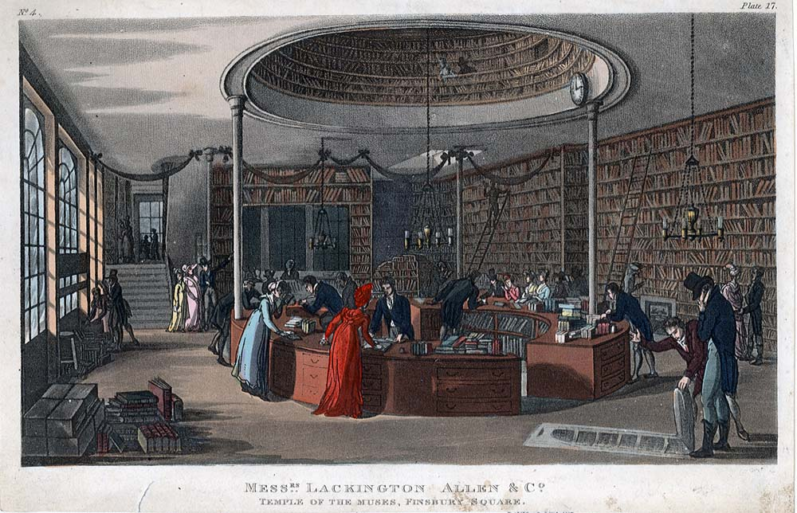
Notes:
Then bookshops became the key curators. This was the glory days of B&N, Waterstones and even Amazon. Books shops have been the key discovery tool for books. But more than that the demands of inventory space and then algorithmically curated stores has meant bookstores are the key interface between content excess and customers - e.g. the key curators of books who control attention, and by controlling attention control the culmination of the entire value chain. Also a story about the change in what publicity is - newspaper reviews sections withered. Again, a sense that the old bastions of control are much less important, but few publishers have changed their publicity strategy.

Slide 23
Notes:
You are the now the most powerful curators around. Lists; word of mouth; social media. We have lost power and control over the conversation by being producers and not curators. Now we need to get back to that as that is where the value will be. More than ever before the person and hand curation of customers dictates what is read, where, and for how much. Ultimately -- whether by the competition of other media or by the collapse of the bookseller-reviewer-publisher trinity, we've lost control of the attention of the audience.

Slide 24
Publishing + Curation:
Readers decide. Readers come first, as they are the primary filters
Imprints, choices and selections should really mean something. Brand can’t be faked in this area
Publish fewer books; publish better books

Slide 25
Notes:
Music comparison - huge wave of high value innovation, from pandora to rdio (who have a curation dial). Echo Nest: Lots of detailed scientific work on curation, blending algorithmic with human. Apple: acquisition of Beats, hiring Trent Reznor, Zane Lowe and Radio 1 BBC producers. Starting to see this wave in the book world, where a lot of effort is going. Amazon purchase of Shelfari back in the day and then Goodreads in 2013. Apple and Book Lamp - tech sees this as a strategic priority. Story in two parts 1.) building the techniology to curate better and 2.) learning new techniques and business mentalities for a ‘post-scarcity’ publishing landscape.

Slide 26
1000s < 10s =
Notes:
At Canelo we have built systems to publish 1000s of books; but we are publishing very few. Technology of production and distribution takes second place to the curation of content. It goes back to the psychology of choice and the problem of excess and information overload on the web. Moreover, our marketing efforts are reader centred - cracking social, cracking the web, cracking new marketing (empowering the reader).

Slide 27
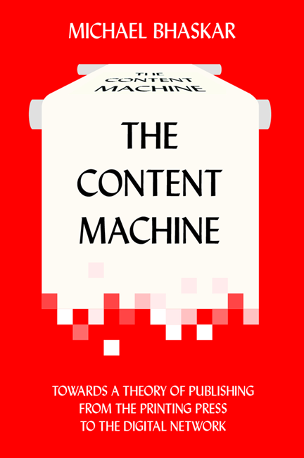
Thank you
@michaelbhaskar
michael@canelo.co

