Slide 1
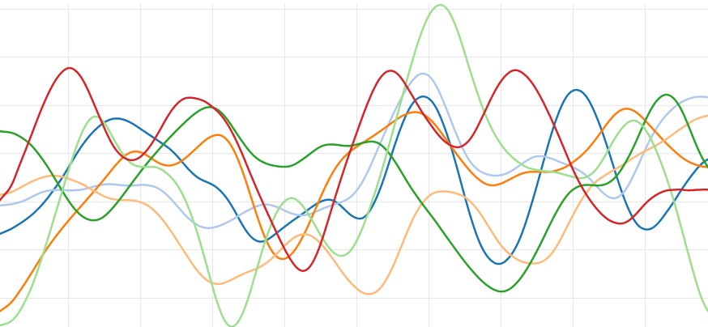
Data Science, Discoverability, and International Expansion for Publishers
BEA 2015 May 28th, 11:55 – 12:30

Slide 2
Natural Language Processing: Processing & Analysis
Natural language analysis tools process English language text input, transforming each sentence into data that can be used for search and analysis.
Identify the base forms of words.
Identify parts of speech.
Identify names of companies, people, places, etc.
Describe the structure of sentences in terms of phrases and word dependencies.
Indicate which noun phrases refer to the same entities.

Slide 3
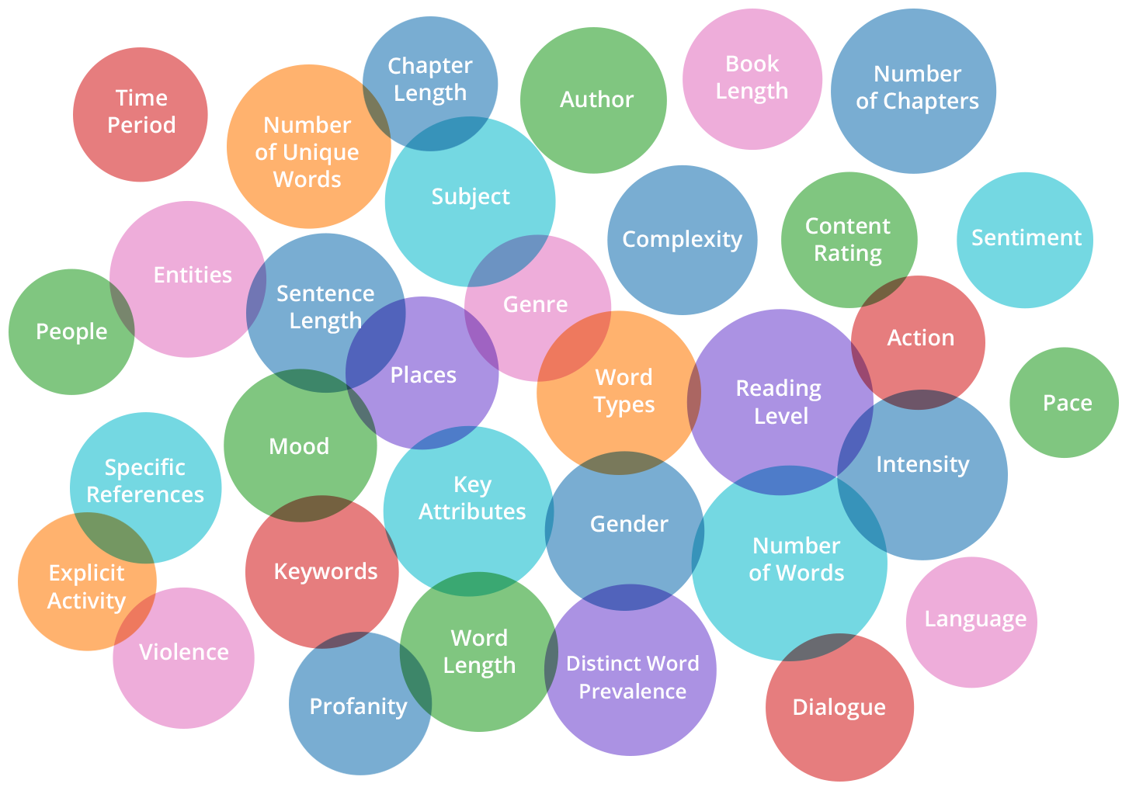
Attributes/Entities that Characterize A Book

Slide 4
Sentiment: Analyzing the Words Within the Book
Each word is given a numeric value based on its subjective meaning.
“Positive” words range on a positive scale; “Negative” words range on a negative scale.
Trajectory’s Analytics Engine uses these values to compute the book’s sentiment curve across sentence, paragraph, chapter and entire book.
This sentiment “fingerprint” at an aggregate level yields a unique picture of the book.
“Outstanding” words (5)
breathtaking, thrilled, superb
“Wow” words (4)
winning, stunning
“Happy” words (3)
praise, marvelous, impressive
“Welcome” words (2)
strengthen, rich, funky
“Yes” words (1):
validate, safe, adequate
“No” words (-1)
numb, provoke, pushy
“Upset” words (-2)
worthless, travesty, threaten
“Terrible” words (-3)
woeful, worsen, kill
“Damned” words (-4)
torture, fraud, (unmentionables)
“Catastrophic” words (-5)
hell, rape, (more unmentionables)

Slide 5
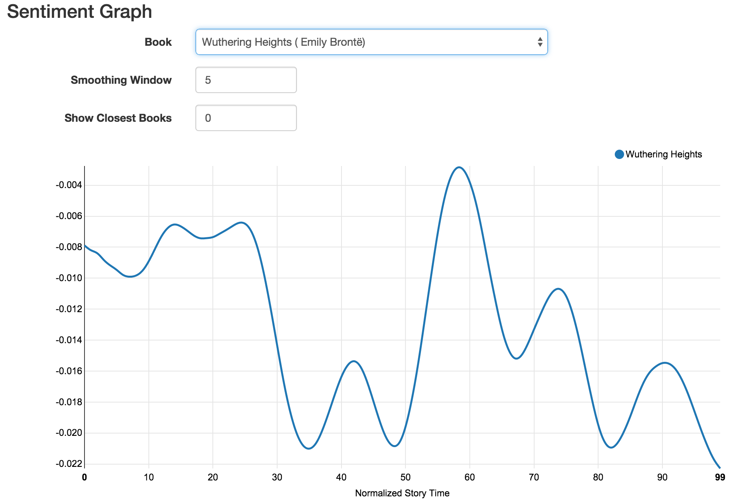
Sentiment: Analyzing the Words Within the Book

Slide 6
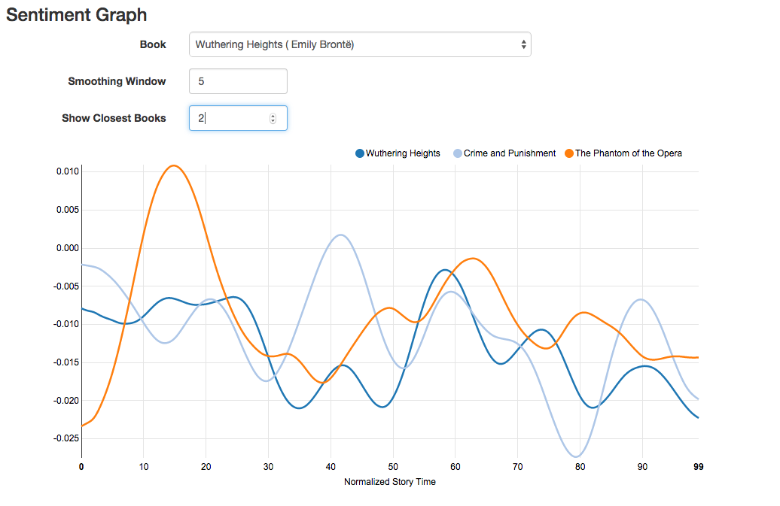
Sentiment: Analyzing the Words Within the Book

Slide 7
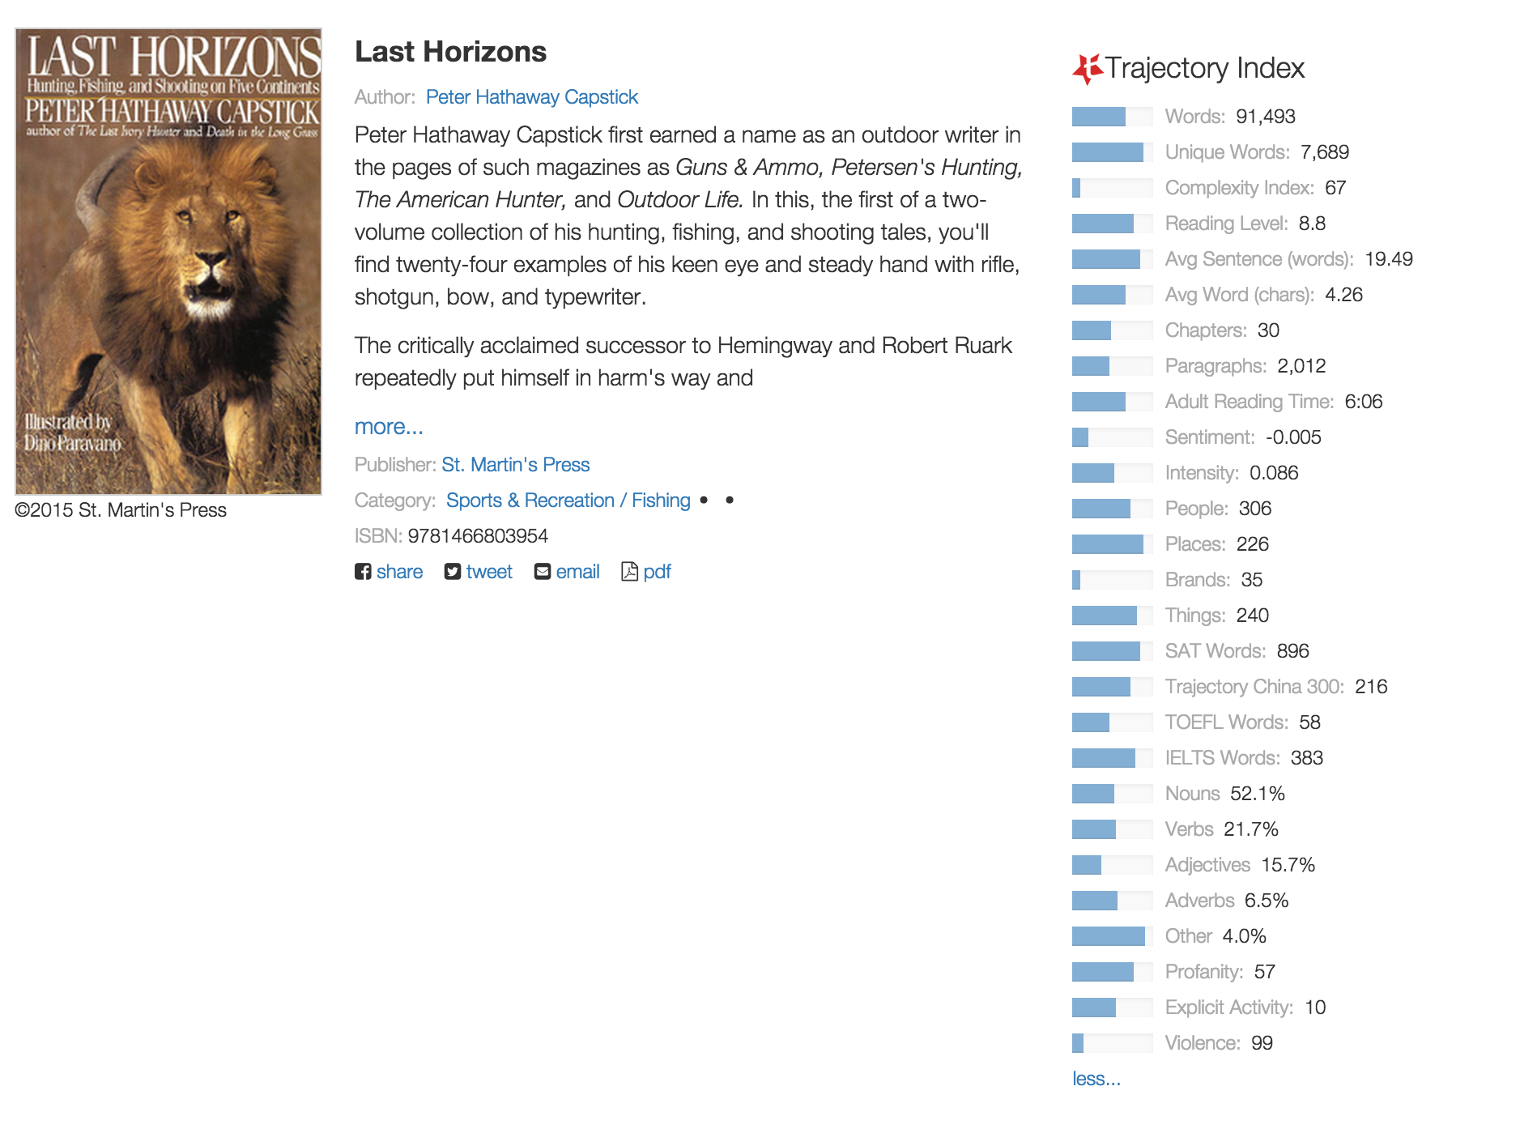
Trajectory Index
Notes:
We generate a highly detailed multi-dimensional profile of contents of the book.
In addition to listing the value associated of each measurable element, we provide the comparative value or Percentile based on all of the books that we have processed.
The occurrence of violence, explicit activity and profanity are measured.

Slide 8
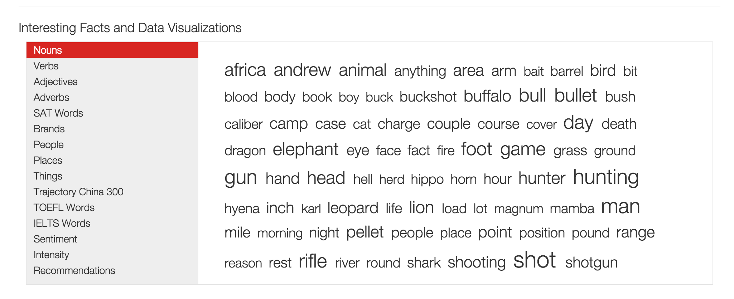
Keyword Analysis and Comparison
Notes:
We compute a weighted score of each word in a book based on a combination of the frequency of the word within the book and the global frequency of the word within that language.
We highlight people, places, key entities, brands, parts of speech and an expanding collection of comparative data sets like SAT/ English Proficiency exams.

Slide 9
Keyword Translation into Local Languages
Notes:
We are now translating keywords into Chinese, German and Spanish. We are sharing this tool with Local retailers to allow them to display the translations to their local audiences with the goal of making it easier for a local reader to quickly grasp the subject of the book through the word cloud.

Slide 10
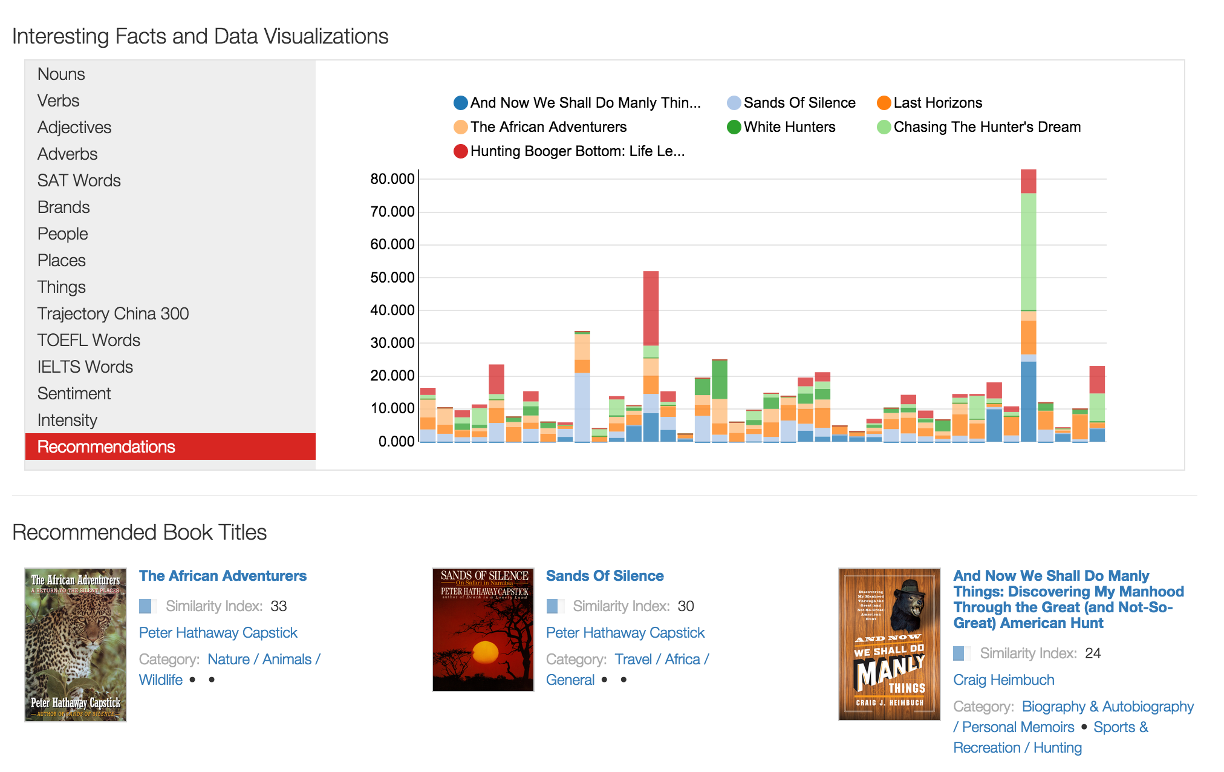
Recommendations

Slide 11
Thank You
2015 BEA – BOOTH 1347
@trajectory
@mytrajectory
@infojedi
United States:
50 Doaks Lane
Marblehead, Massachusetts
01945 United States
info@trajectory.com
www.trajectory.com
China:
No. 3, 8 Chuang Ye Road
Haidan District,
Beijing, China 100085

